Slide 1

Travel Planner
A major project report submitted in partial fulfilment of the requirements for the award of the Degree of Bachelor of Technology.
Submitted By:
Satyabrata Brahmachary- 2001292126
Shishir Ku. Mohanta- 2001292130
Nishant S. Sahoo- 2001292108
Biswajit Biswal- 2001292257
Under the Supervision:
Asst. Prof. Sarmistha Nanda
CSE Dept.

Slide 2
AGENDA
Introduction
1.1 Overview of the Project
1.2 Basic concept of the project
1.3 Motivation of the project
1.4 Objective of the project
2. Requirement Analysis and System Specification
2.1 System Specification
2.2 SDLC to be used
3. System Design
3.1 Data Flow Diagram
3.2 Flowchart
3.3 Entity Relationship Diagram
4. Result and Discussion
5. Conclusion
6. Future Scope
7. Key References

Slide 3
INTRODUCTION
Overview of the project:
The Travel Planner project is an innovative application designed to streamline and enhance the travel planning experience for users.
With a user-friendly interface, the project aims to provide a comprehensive platform where individuals can effortlessly plan and organize their trips. The application facilitates itinerary creation, accommodation booking, and activity scheduling, offering users a centralized hub for all their travel needs.
This project not only simplifies travel logistics but also fosters community engagement by allowing users to share itineraries, tips, and reviews.

Slide 4
Basic Concept of the Project
Travel Planner project is a Web based application.
Basically our project is a Recommendation System that will recommend place according to the user interests.
The Travel Planner suggests personalized recommendations based on user preferences, ensuring a tailored and memorable travel experience.
Through seamless integration with mapping services and real-time updates, users can navigate their destinations efficiently.
Reference: www.makemytrip.com

Slide 5
Motivation Of the Project
The desire to explore new destinations and immerse oneself in different cultures has never been stronger.
However, amidst the excitement of travel, the process of planning can often become overwhelming and time-consuming.
Recognizing this common challenge, our motivation for embarking on the travel planner project stems from a deep commitment to simplifying and enhancing the travel planning experience for individuals and families alike.

Slide 6
Objective of the project
The objective of the travel planner project is to curate personalized and seamless travel experiences for clients, catering to their unique preferences, interests, and budgets.
By leveraging comprehensive destination research and expert itinerary creation, the project aims to deliver memorable journeys that exceed client expectations.
Additionally, the project seeks to provide exceptional customer service and support throughout the entire travel planning process, ensuring a stress-free and enjoyable experience for every traveler.
Ultimately, the goal is to foster long-term relationships with clients and establish the travel planner project as a trusted provider of bespoke travel solutions.

Slide 7
Requirement Analysis and System Specification:
Requirement analysis for a travel planner project involves identifying and documenting the needs, preferences, and constraints of both users and stakeholders.
This phase aims to understand the scope of the project, define features, and outline objectives.
Additionally, analyzing existing systems and market research helps in identifying potential gaps and opportunities.
The outcome of requirement analysis serves as a foundation for designing the system architecture and developing the travel planner application to meet the identified needs effectively.

Slide 8
System Specification:
The Requirements phase of a project involves gathering, documenting, and clarifying the needs and expectations of stakeholders. It establishes a foundation for the project by defining what the system or product should accomplish, specifying features, constraints, and functionality
Data Requirement
Functional Requirement
Performance Requirement
Dependability Requirement
Maintainability Requirement
Security Requirement

Slide 9
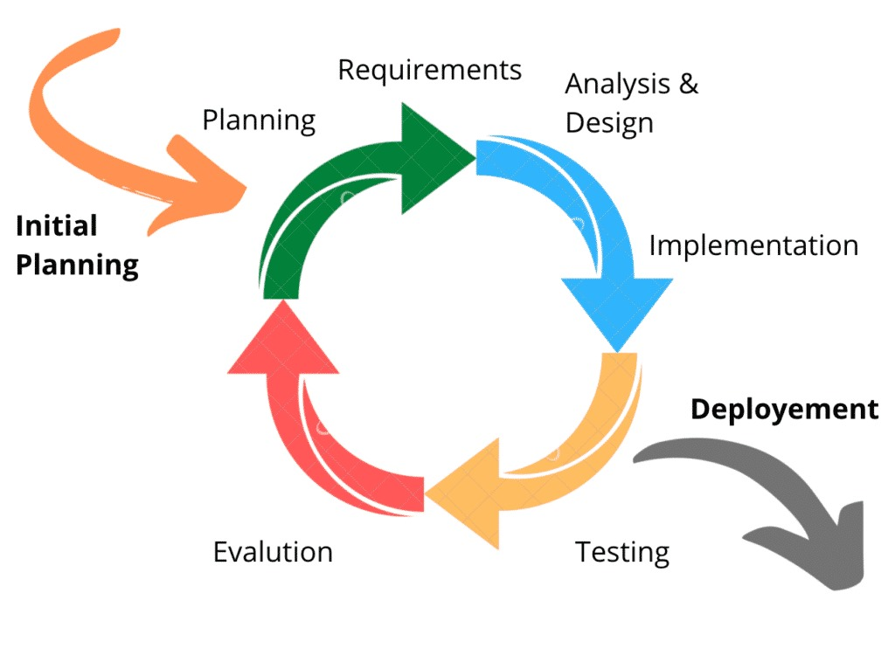
SDLC Model to be used:
Agile Methodology is used as it helps to ensure that development complete projects on time and within budget.
The Agile model in software development is a iterative and flexible approach focused on delivering small, incremental releases of software, rather than one large, final product. It emphasizes collaboration, adaptability, and customer feedback throughout the development process.
Agile teams work in short cycles called sprints, typically lasting 1-4 weeks, where they plan, develop, test, and deliver working software increments.
Continuous communication between developers, stakeholders, and customers ensures that requirements are well understood and can be adjusted as needed.
Agile modeling helps developers create a customized software development process that fulfills their development needs yet is flexible enough to adjust to future situations.
Figure 1: Agile Model
[Reference :www.mygreatlearning.com]

Slide 10
SYSTEM DESIGN
Two common design approaches are function-oriented design and object-oriented design.
In an object-oriented design, the system is modelled as a collection of objects that represent real-world entities. These objects encapsulate data and behaviour, promoting modularity and reusability.
System design for a travel planner project involves specifying how the system will fulfil the requirements. Here are some commonly used tools and techniques in the context of a travel planner project:
Data Flow Diagram(DFD)
Data Dictionary
Flowchart
Entity Relationship(ER) Diagram

Slide 11
DFD Diagram
A data flow diagram is a graphical representation or technique depicting information flow and transform that are applied as data moved from input to output.
The DFD are partitioned into levels that represent increasing information flow and functional details.
The processes, data store. data flow, etc are described in Data Dictionary.
There are 3 levels of DFD
Zero Level DFD
First Level DFD
Second Level DFD

Slide 12
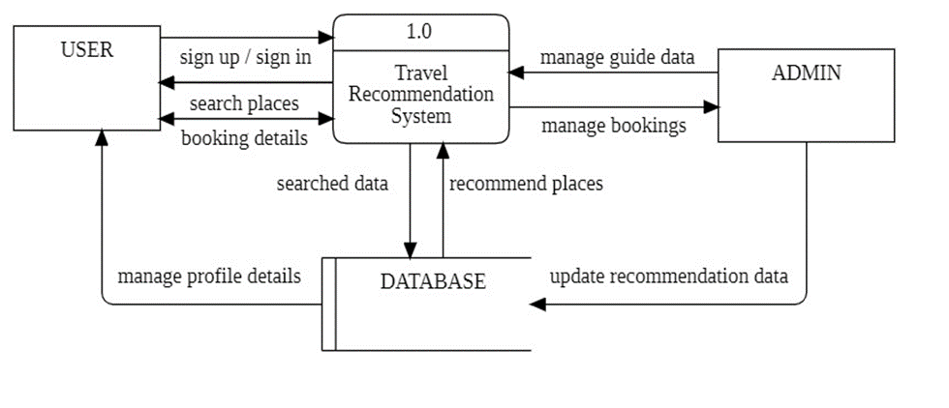
Zero Level DFD
The Zero Level Data Flow Diagram (DFD) for the Travel Planner Project provides a high-level overview of the system's functionality without delving into specific processes.
At this level, the diagram typically showcases the main external entities interacting with the system, such as users and external databases.
The Zero Level DFD illustrates the basic input and output interactions between these entities and the central system, offering a simplified yet comprehensive view of the overall flow of information within the travel planning system.
Figure 2: Level 0 Data Flow Diagram

Slide 13
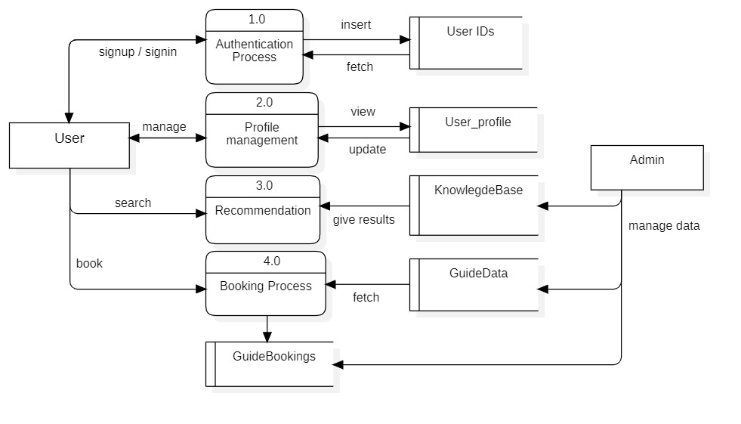
First Level DFD:
A Level 1 Data Flow Diagram (DFD) for a Travel Planner project provides a high-level overview of the system's functionality, illustrating the main processes and data flows within the system.
In a travel planner system, users typically input their travel preferences, and the system helps them plan their trips by providing information on destinations, accommodations, transportation, and other relevant details.
Figure 3: Level 1 Data Flow Diagram

Slide 14
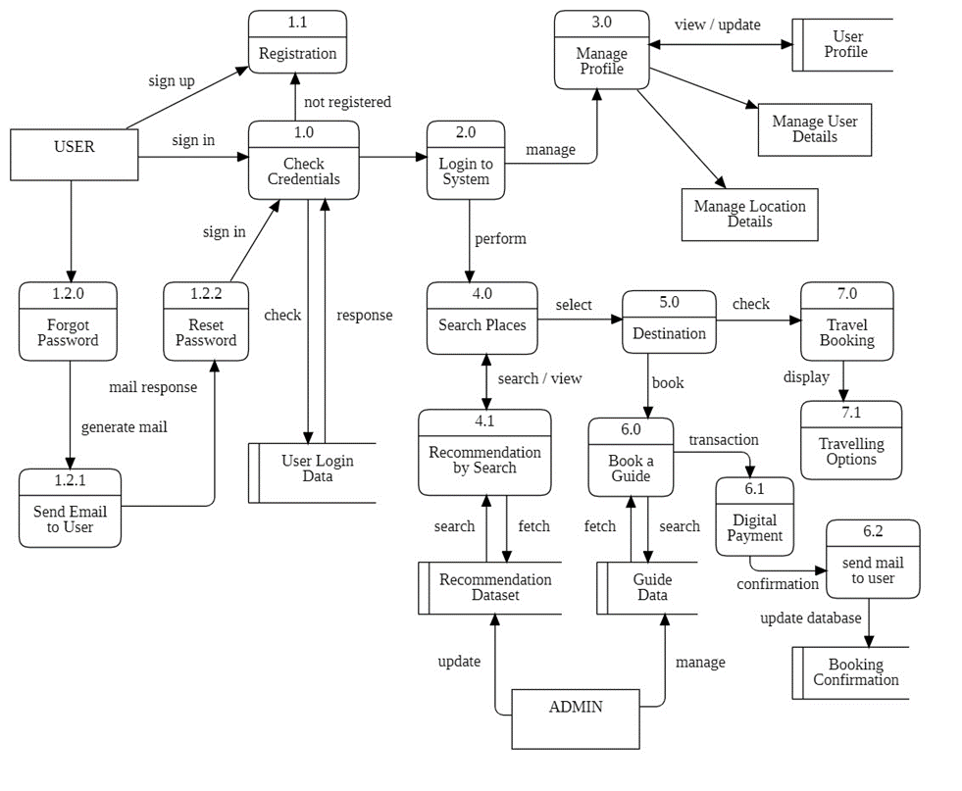
Second Level DFD:
A Level 2 Data Flow Diagram (DFD) for a Travel Planner project provides a more detailed view of the system than the Level 1 DFD. It breaks down the major processes identified in the Level 1 DFD into sub-processes and illustrates the flow of data between them.
In the context of a Travel Planner project, the Level 2 DFD can capture more specific functionalities and interactions within the system.
This Level 2 DFD provides a more granular view of the Travel Planner system, outlining specific tasks and data interactions within each major process
Figure 4: Level 2 Data Flow Diagram

Slide 15
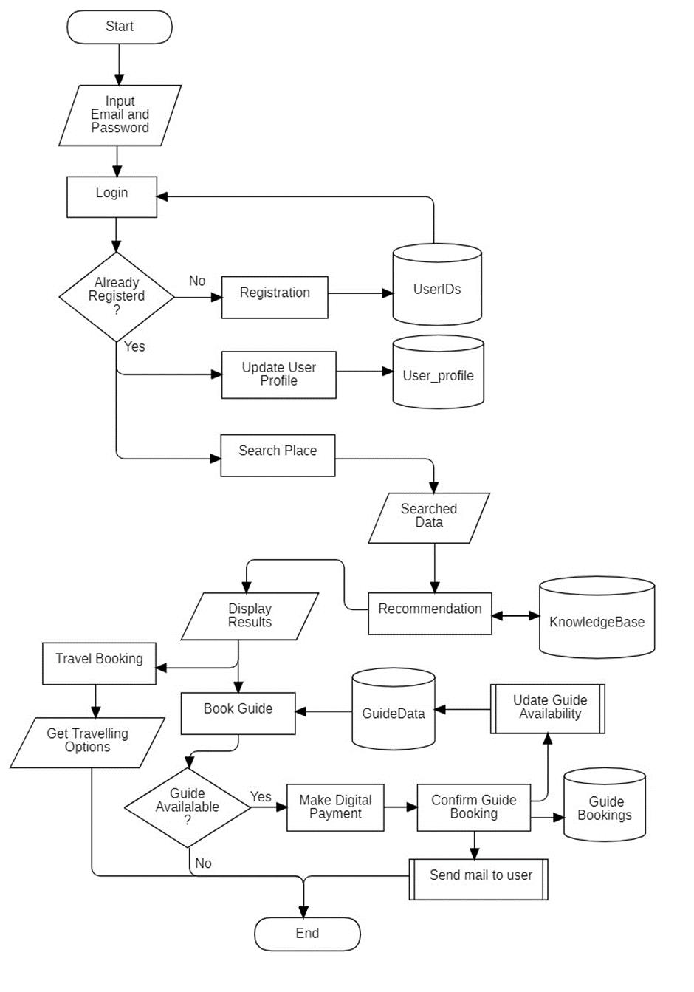
ii. Flowchart
A flowchart is a visual representation of the sequence of steps and decision points in a process. It is commonly used to outline the flow of a project, breaking it down into individual tasks and showing how they relate to each other.
A system flowchart shows how parts of a system work together, by displaying how data flows through the system and how decisions affect this process.
They connect labelled, standardized symbols with lines to show everything users might do in interactive contexts.
A system flowchart shows how parts of a system work together, by displaying how data flows through the system and how decisions affect this process.
Figure 5: Flowchart

Slide 16
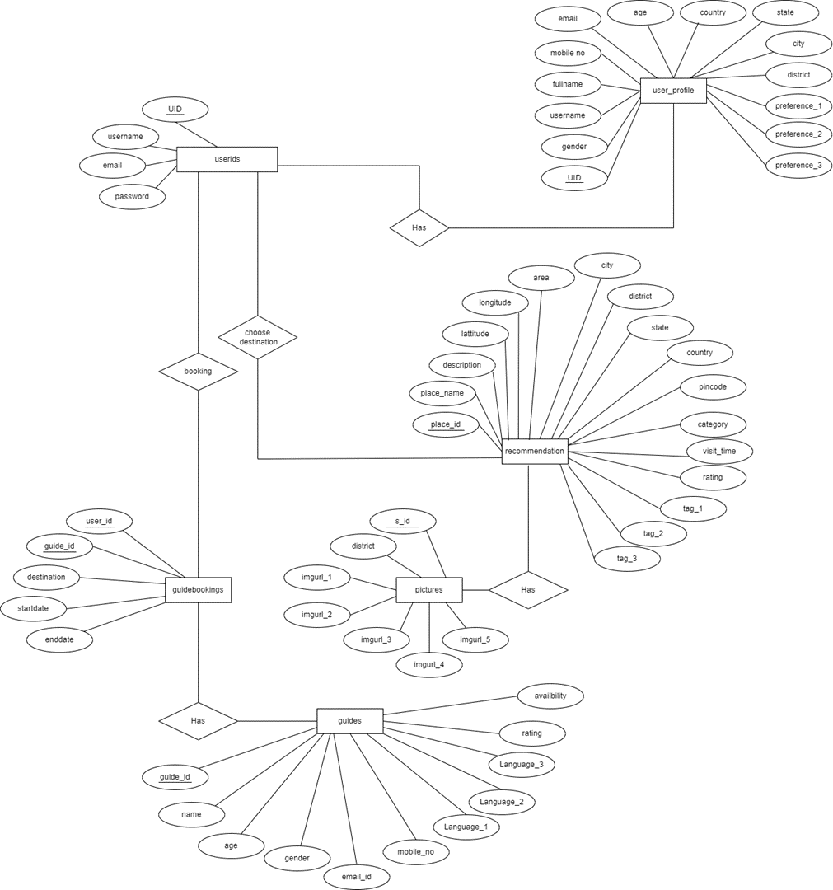
iii. ER Diagram
ER Diagram stands for Entity Relationship Diagram, also known as ERD is a diagram that displays the relationship of entity sets stored in a database. ER diagrams help to explain the logical structure of databases.
ER diagrams are created based on three basic concepts: entities, attributes and relationships. ER Diagrams contain different symbols that use rectangles to represent entities, ovals to define attributes and diamond shapes to represent relationship.
Figure 6: ER Diagram

Slide 17
RESULTS AND DISCUSSION
Our team presents the outcomes of extensive testing and analysis conducted on our innovative travel planning platform. Through comprehensive user feedback and performance metrics, we evaluate the efficacy of our planner in facilitating seamless itinerary creation and optimizing travel routes. Statistical data and user testimonials are showcased to illustrate the planner's ability to tailor travel experiences to individual preferences while ensuring efficiency and convenience.
This section serves as a validation of the effectiveness of our travel planner while providing valuable insights for its ongoing refinement and widespread adoption.
We have included below some of the snapshots of our project :

Slide 18
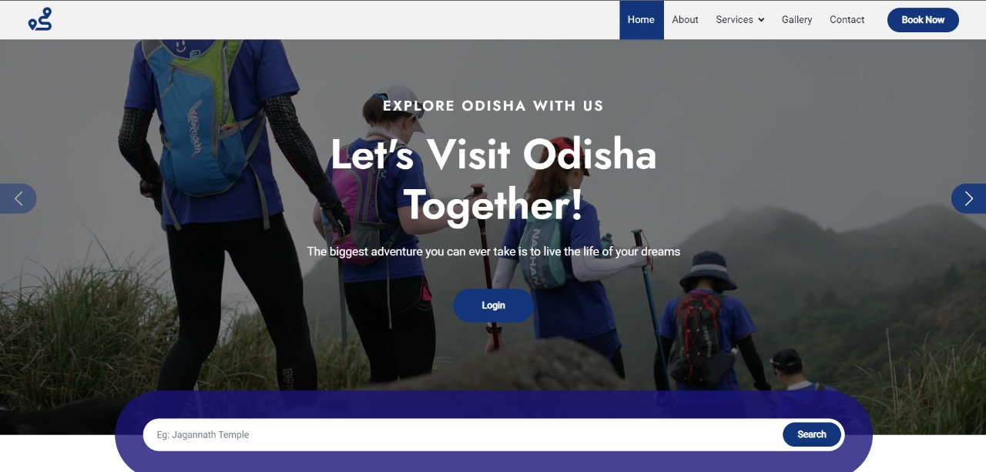
HOME PAGE

Slide 19
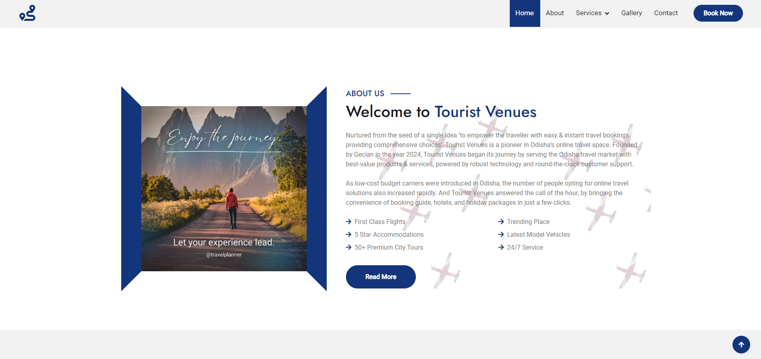
ABOUT PAGE

Slide 20
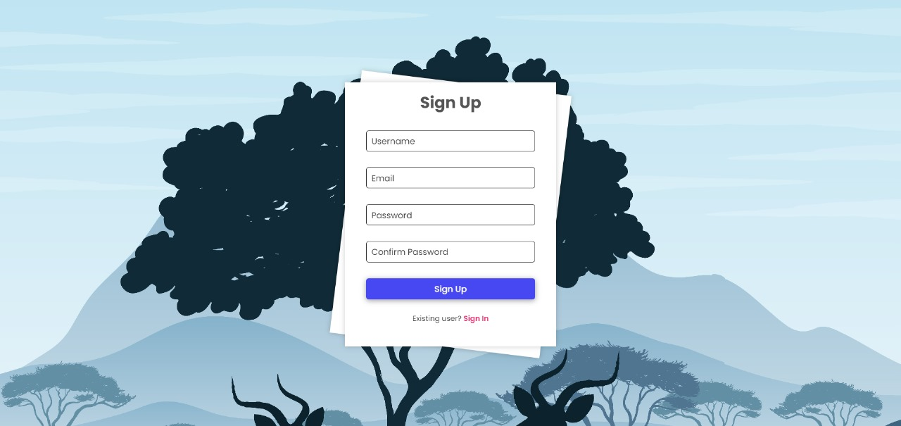
SIGN UP PAGE

Slide 21
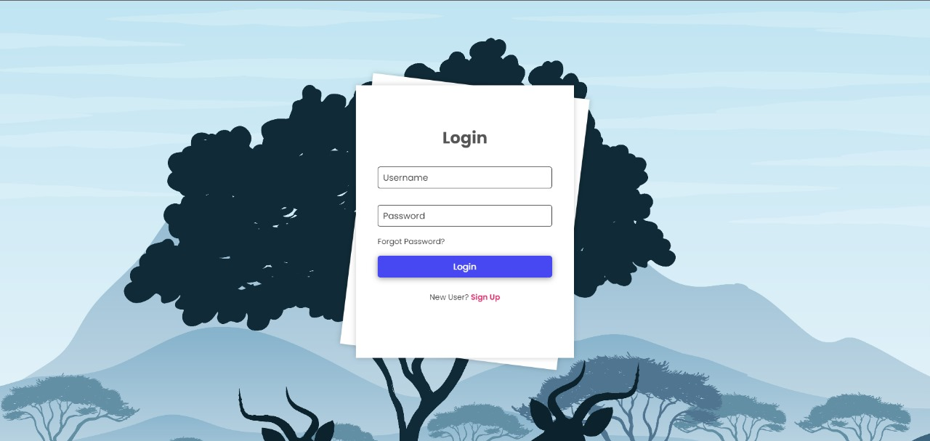
LOGIN PAGE

Slide 22
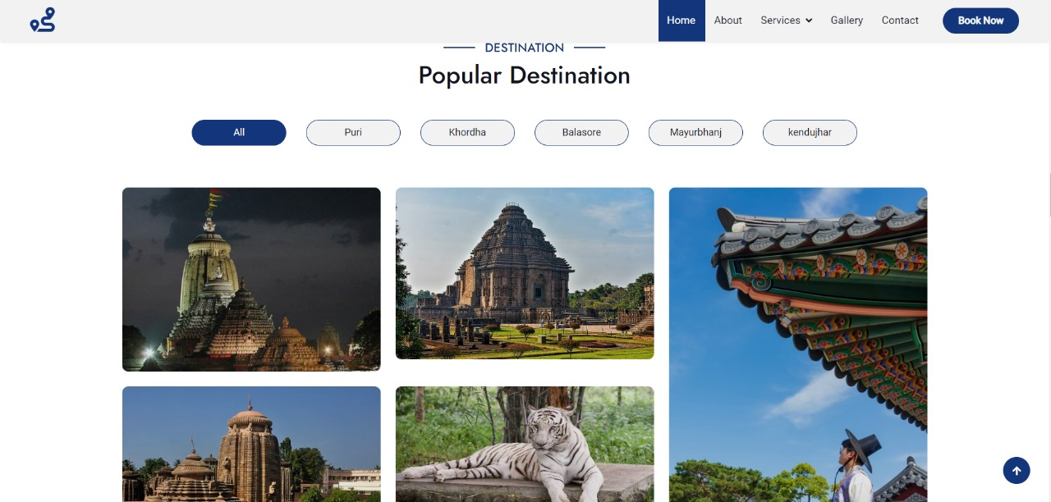
DESTINATIONS

Slide 23
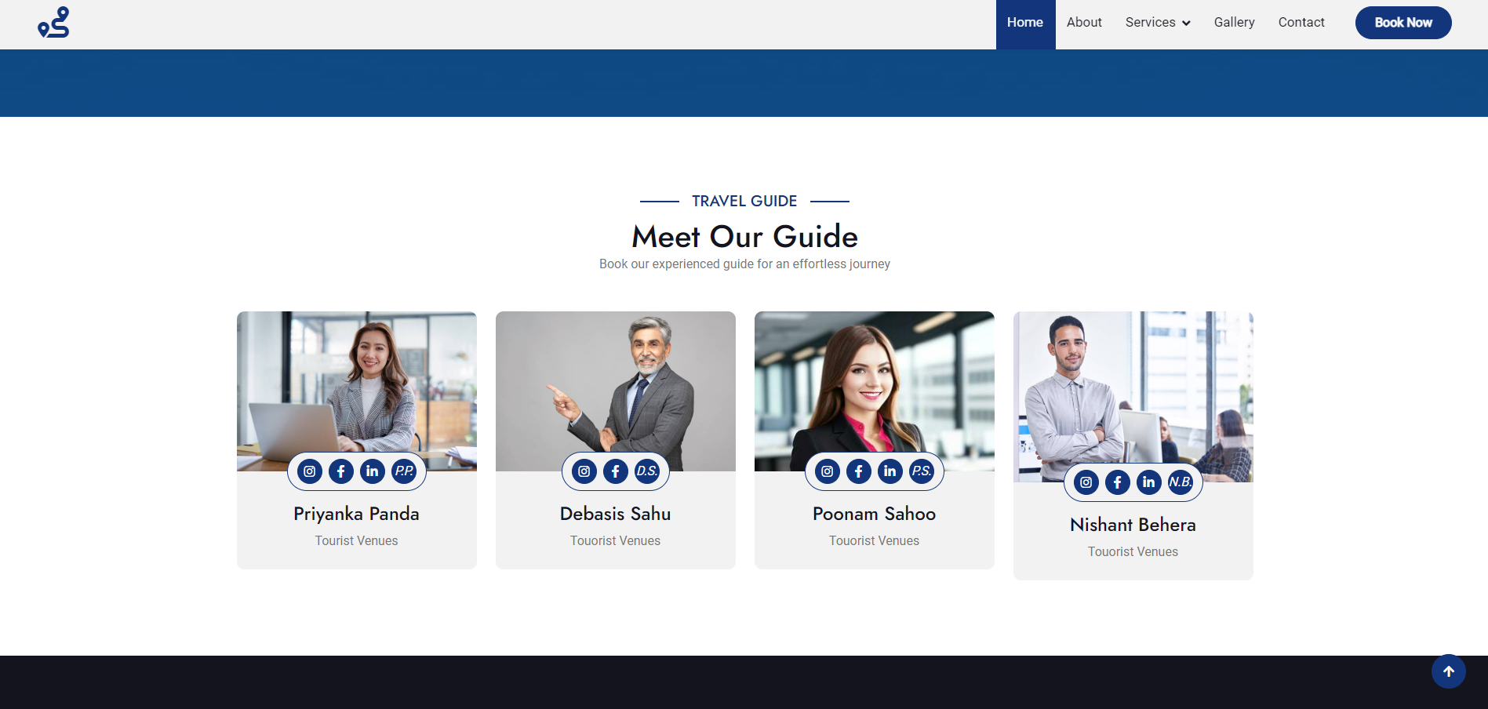
GUIDES

Slide 24
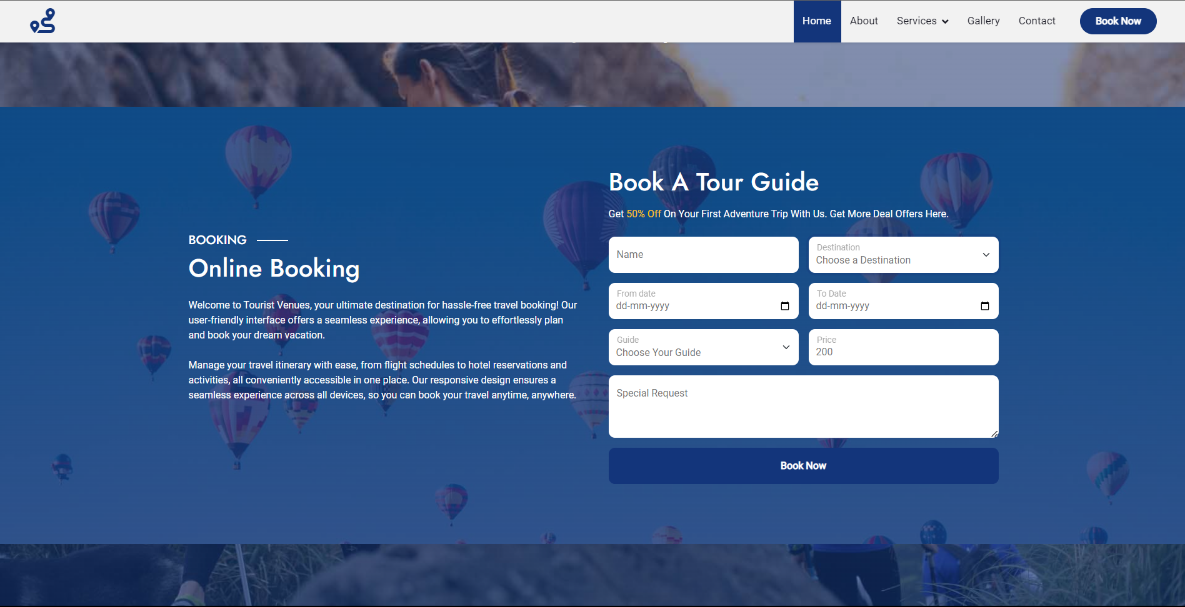
GUIDE BOOKING

Slide 25
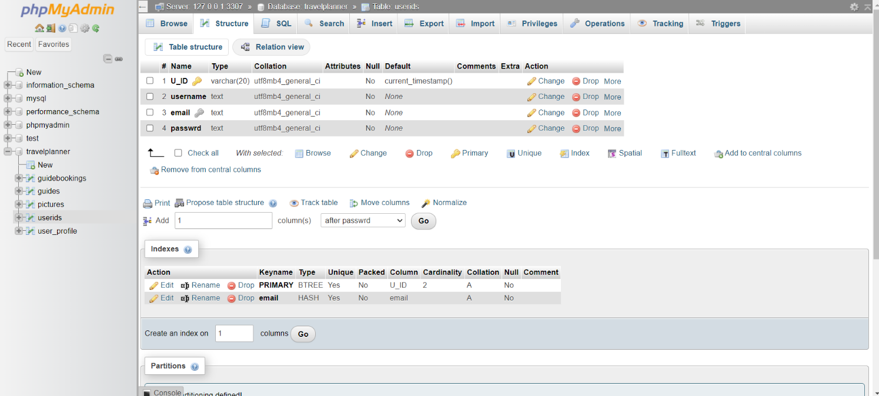
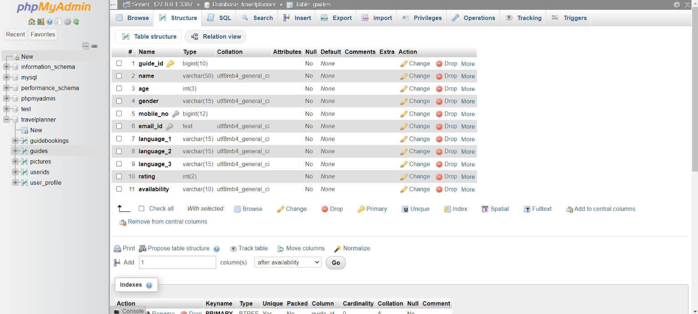
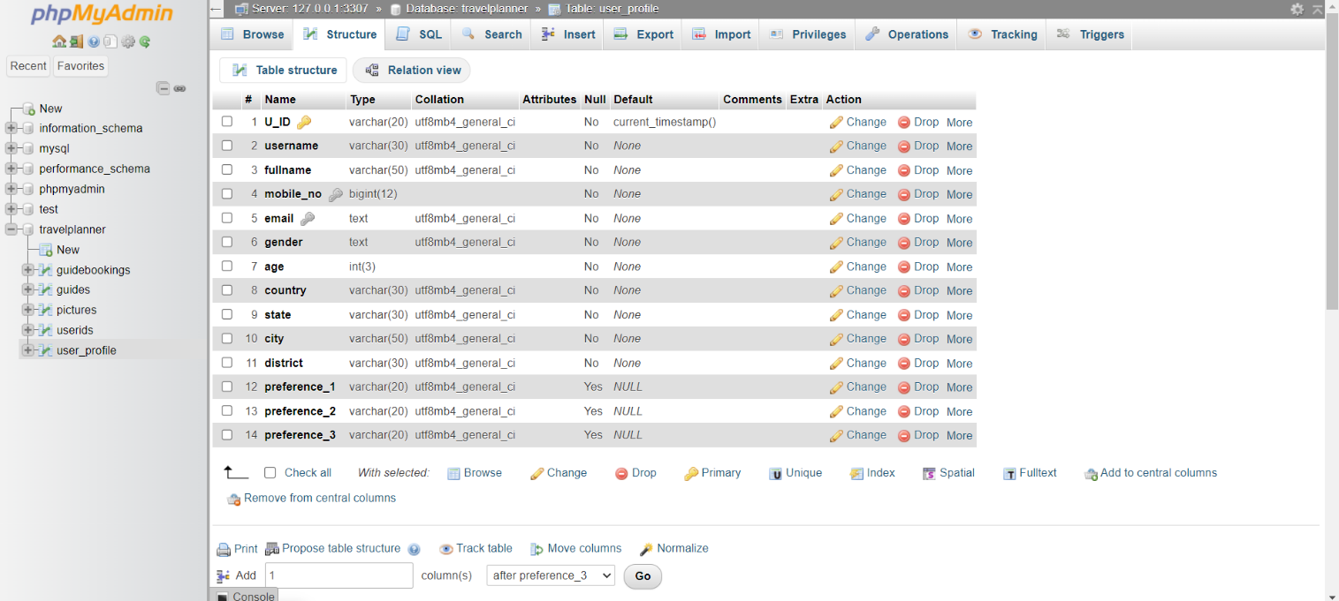
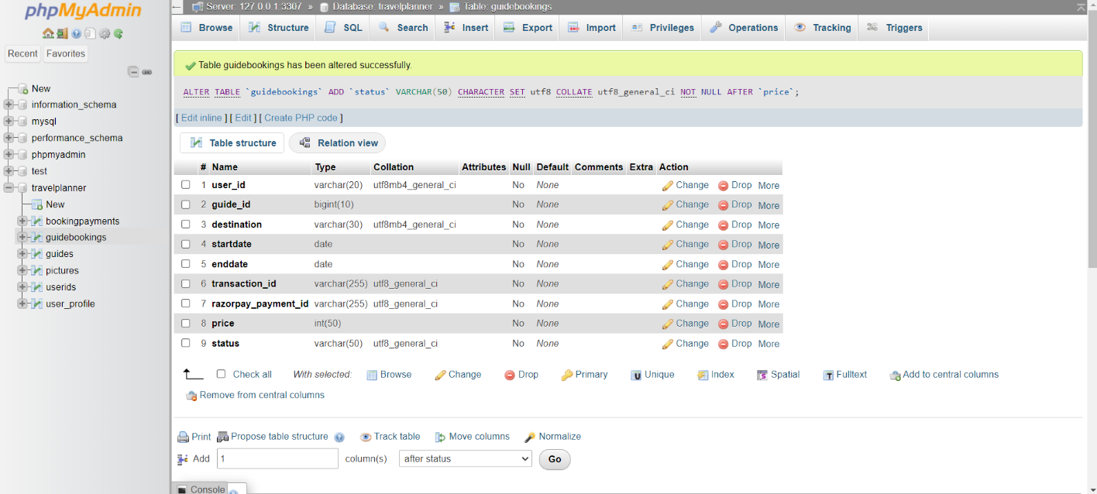
Database Representation
User id database
User Profile Database
Guide Database
User Booking Database

Slide 26
CONCLUSION
In the culmination of our travel planner project, we find ourselves reflecting on the journey we undertook to create a comprehensive and user-friendly tool for travellers.
From the inception of the idea to the final implementation, our team dedicated countless hours to ensure that the travel planner not only meets but exceeds the expectations of users seeking a seamless and enjoyable travel experience.
The integration of artificial intelligence allowed us to provide personalized recommendations, enhancing the user's ability to create a tailored itinerary.
In closing, we express our gratitude to everyone who contributed to the success of this project.

Slide 27
FUTURE SCOPE
The future scope for a travel planner project is vast and promising, as the travel industry continues to evolve with technological advancements. Here are some potential areas of growth and development for a travel planner project:
1. Personalized AI-driven Recommendations
2. Smart Travel Itineraries with Real-Time Updates
3. Continuous Machine Learning for Improved Recommendations
4. Global Expansion and Multi-Language Support

Slide 28
Key References :
https://www.easemytrip.com/ : last accessed 02/04/2024
https://www.php.net/manual/en/book.mysql.php :last accessed 05/04/2024
https://app.diagrams.net/ : last accessed 08/04/2024
https://youtu.be/1xtrIEwY_zY : last accessed 07/04/2024
https://www.geeksforgeeks.org/ : last accessed 03/04/2024
https://www.gliffy.com/blog/guide-to-flowchart-symbols :last accessed 08/04/2024

Slide 29
THANK YOU
Satyabrata Brahmachary
Nishant S Sahoo
Biswajit Biswal
Shishir Kumar Mahanta

